Slide 1
OOP Project Dorset
Team 14 :
Yoan Gabison ; Baptiste Gaidou ; Clarysse Gielen ; Paul Froidefond ; Quentin Navarre (Group A); Eliott Tourtoulou
Git URL : https://github.com/BaptisteGaidou2/Dorset-OOP

Slide 2
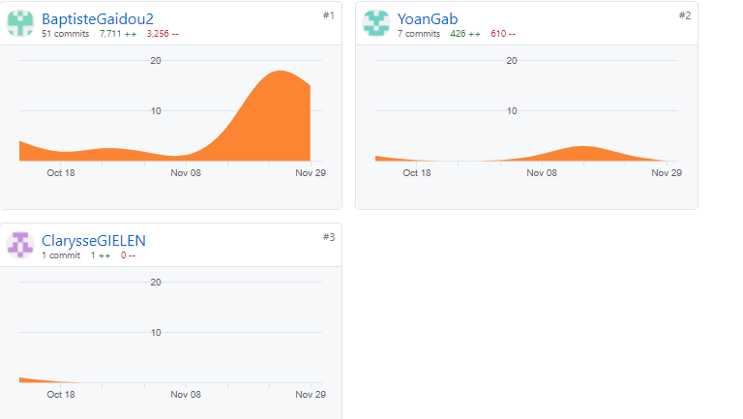
Work Distribution
Githubs commits :
PowerPoint Preparation : Eliott, Baptiste, Clarysse
UML diagram : Baptiste Gaidou, Yoan
Code Report : Eliott, Paul, Baptiste

Slide 3
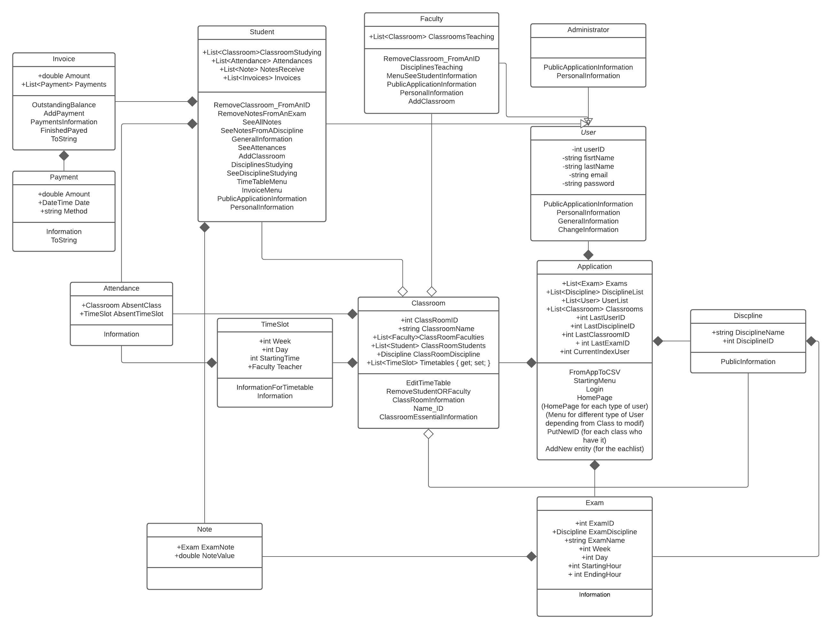
UML Diagram

Slide 4
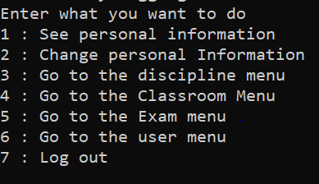
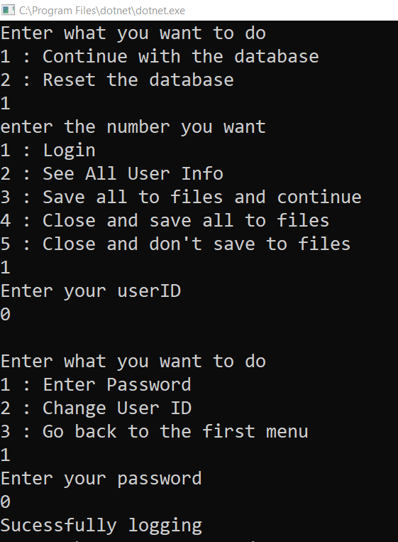

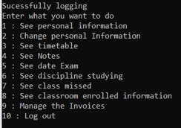
Our Program in Action
Home Page for Administrator
Home Page for Faculty
Home Page for Student
Login

Slide 5
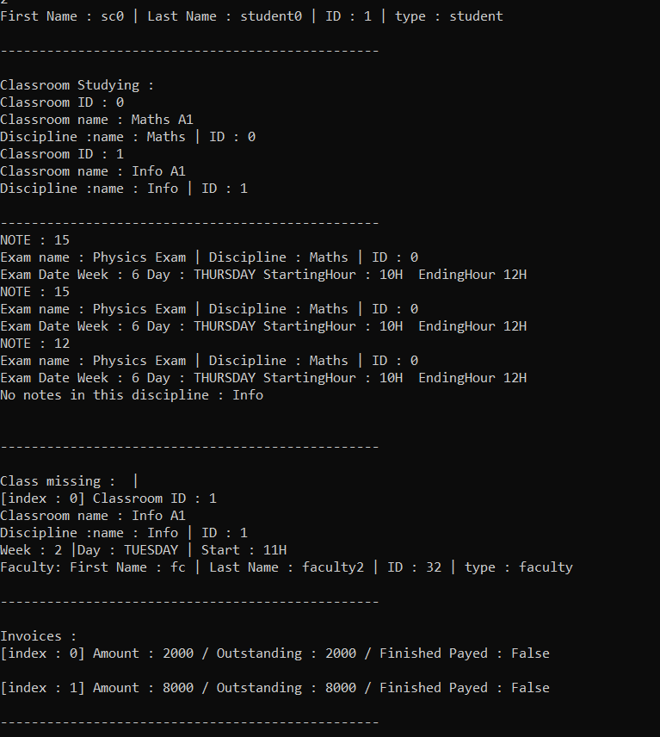
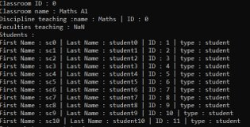
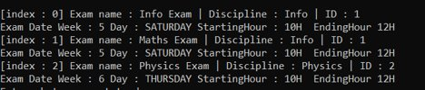
Our Program in Action
Classroom Information
User Information
Exam Information

Slide 6
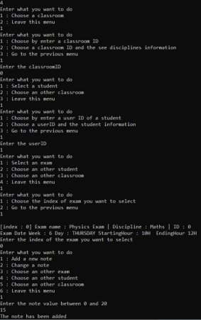
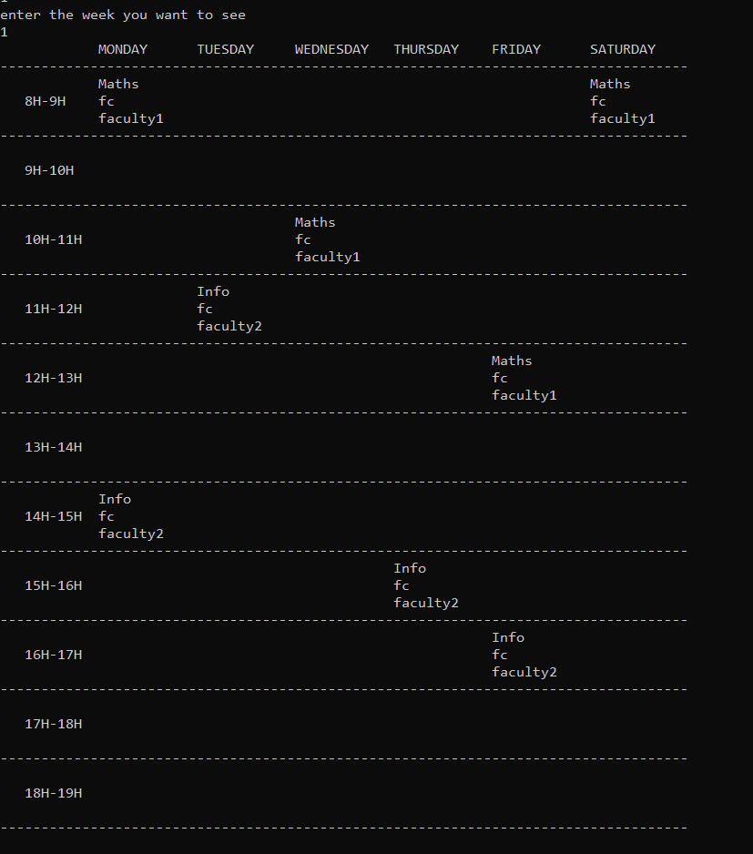
Manage mark
Timetable

Slide 7
Key Topics we chose
Mandatory features that we implement:
Administrator Login with Super Privileges for creating courses, timetables etc.
Faculty Login with Privileges pertaining to their students
Student Login with privileges that only permits the to see details pertaining to them.
Manage Student Registration and Enrolment in courses.
Additional features that we choose besides the mandatory ones :
Manage Exams, Assignments and Results.
Manage Student Attendance.
Manage Timetable.

Slide 8
Let’s run the project ...

Slide 9
What did we learn from doing this project ?
New skills acquired with the project :
Abstract Classes
Use of GitHub
Class inheritance
Database handling
UML Diagram
Old skills used in the project :
Classes and Objects
Console Application in C#

